Slide 1
BCOG 100
Pattern Recognition
Lecture 3: Brain Implementation

Slide 2
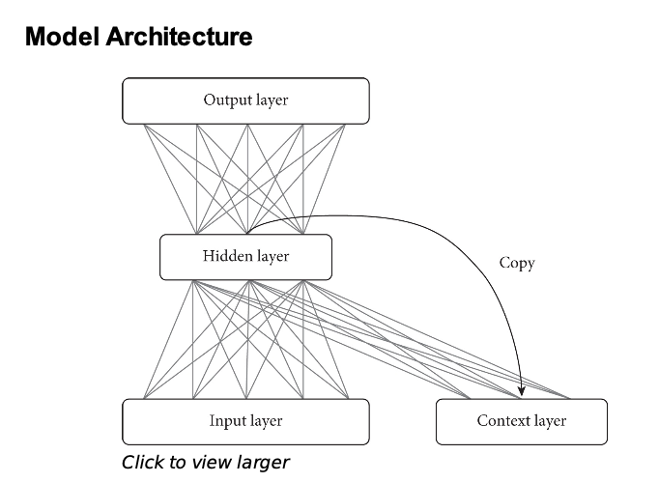
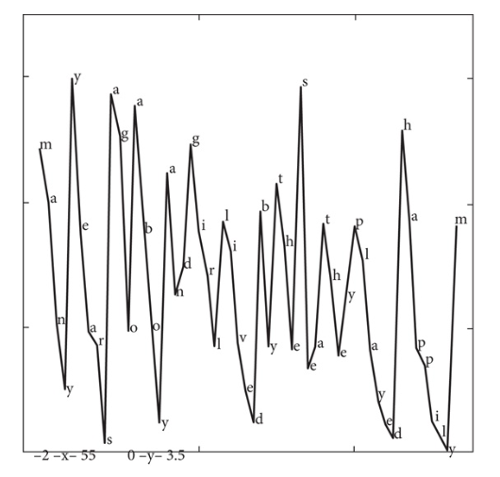
Reading Check 7-3. Password: srn Question: Explain this.
MANYYEARSAGOABOYANDGIRLLIVEDBYTHESEA

Slide 3
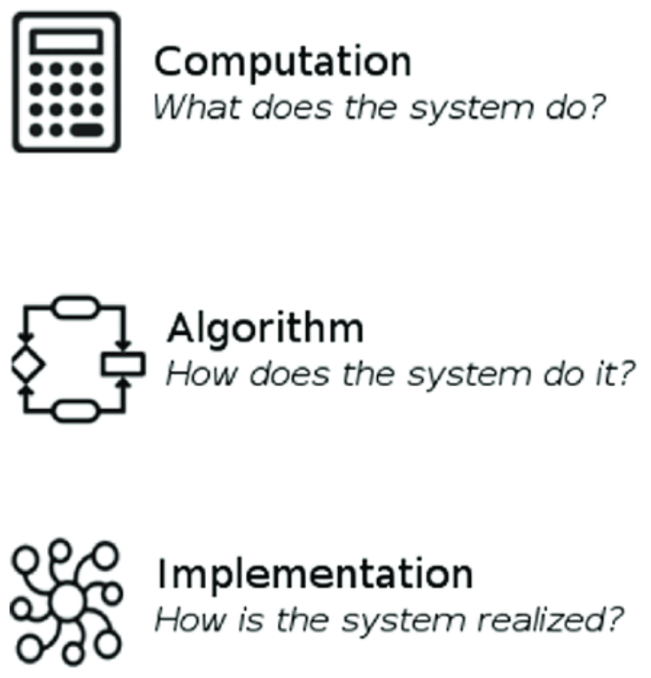
Pattern Recognition in the Brain
Recap & Overview
The problems of pattern recognition, and algorithms for dealing with those problems
Today:
How brain systems implement those algorithms
Neural mechanisms, sensory systems, and brain structures
Notes:
So far, we’ve seen two perspectives on the problem of pattern recognition. In Lecture 1, we framed the functional question
—how a system can detect regularities and categorize the world despite noise, ambiguity, and variation. In Lecture 2, we explored algorithmic solutions
—distributed representations, hierarchical organization,
and learning mechanisms that allow systems to generalize from experience.
Today we move to the implementational level: how real neural circuits achieve these same goals. We’ll see that the brain’s architecture embodies the very same principles we studied computationally
We’ll look at neural mechanisms like distributed and sparse coding, hierarchical feature extraction, and predictive feedback—implemented in biological hardware.
We’ll look at how our sensory systems evolved to provide specialized input for our pattern recognition systems,
And we’ll look at the brain systems that evolved to process and integrate those sensory inputs.
The goal is to show that these abstract ideas are not just metaphors for the brain; they are instantiated in real tissue. Understanding how helps us see why certain computational strategies recur again and again—in both evolution and AI.

Slide 4
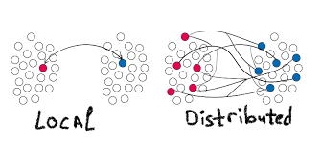
Pattern Recognition in the Brain
Distributed and Sparse Coding
Patterns across populations
Sparse activation
Efficiency and robustness
Notes:
Information in the brain typically isn’t carried by single “detector” neurons but by patterns of activity across many cells.
Each neuron responds to a range of inputs, and meaning comes from the overall configuration of firing across the population.
This is what we call distributed coding—it’s how the brain represents information flexibly and robustly.
But the brain also keeps its activity sparse.
At any given moment, only a small fraction of neurons are active, which saves energy and helps keep representations distinct.
If two experiences activate overlapping sets of neurons, interference becomes a problem—so sparsity helps prevent confusion.
We see these principles everywhere.
In the olfactory bulb, odors activate overlapping but distinct ensembles of neurons.
In the motor cortex, the direction of a movement can be predicted from the population vector of many broadly tuned neurons.
And in visual cortex, overlapping tuning curves for orientation and color create a distributed map of the visual world.
Distributed and sparse coding together give the brain an efficient, noise-tolerant way to represent patterns
—one that mirrors the strategies we use in artificial neural networks.

Slide 5
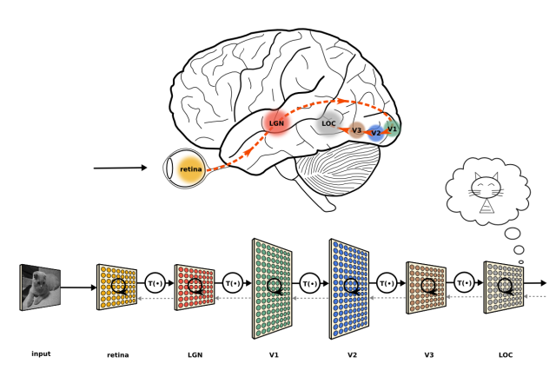
Pattern Recognition in the Brain
Hierarchical Representation and Abstraction
Simple to complex
Feature combinations
Abstraction and invariance
Notes:
The idea of pattern recognition in brains didn’t start with computers—it started with cats.
Thorndike’s puzzle-box experiments at the turn of the 20th century
used cats to show that behavior could be shaped by trial and error.
They learned patterns of context and action that predicted reward
—an early demonstration of the Law of Effect and reinforcement learning.
Half a century later, cats again became central
—this time for understanding how neurons recognize patterns in sensory input.
Hubel and Wiesel’s experiments in the 1950s and 60s were built on an elegant but simple method.
Under light anesthesia, a cat’s visual cortex was exposed for recording.
They projected bars or edges of light onto a screen in front of the cat’s eyes
and recorded the electrical activity of single neurons with fine glass microelectrodes.
By rotating and moving the light bar,
they found that each neuron responded strongly only to certain orientations or directions of motion.
These “simple cells” responded to specific edge orientations at precise retinal locations,
while “complex cells” combined the outputs of many simple cells to detect the same edge anywhere in their receptive field.
That progression—from small, local features to more abstract, invariant ones
—demonstrated that the visual cortex is organized hierarchically, with each layer building on the one below.
This was one of the first times anyone had traced an actual neural circuit performing pattern recognition.
It linked behavior to biology:
Thorndike’s cats had learned behavioral patterns;
Hubel and Wiesel’s cats revealed the neural mechanisms for detecting visual ones.
Their work also provided the blueprint for modern deep neural networks,
where hierarchical feature extraction achieves similar abstraction and invariance.

Slide 6
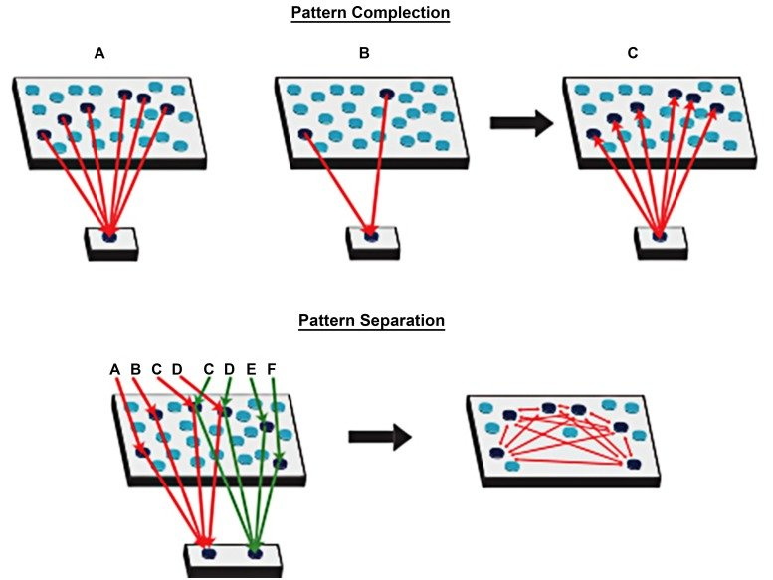
Pattern Recognition in the Brain
Pattern Separation and Completion
Keeping memories distinct
Filling in missing input
Hippocampal mechanisms
Notes:
Pattern separation makes similar inputs more distinct.
In the hippocampus, this function is performed by the dentate gyrus, which receives dense input from the cortex but responds with very sparse activity.
Only a few neurons fire for any given experience, and those neurons change depending on the exact combination of inputs.
By spreading patterns apart in this way, the brain keeps new memories from blurring into old ones.
Pattern completion is the opposite process.
Another hippocampal region, CA3, contains many recurrent connections among its neurons.
When a partial cue activates part of a stored pattern, those connections re-activate the rest, filling in the missing details.
It’s the brain’s way of recognizing something familiar even from a fragment—like recalling a song from just a few notes.
Together, these mechanisms allow the hippocampus to keep memories distinct yet retrievable.
Computationally, they prevent interference and make recall robust even when the input is noisy or degraded.
This balance—between separating patterns and completing them—is one of the brain’s most elegant solutions to the challenge of continual learning.

Slide 7
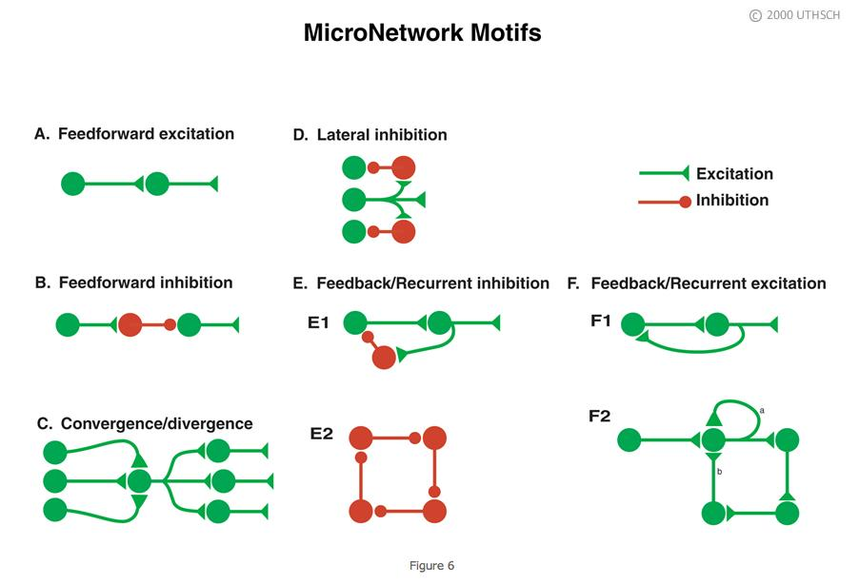
Pattern Recognition in the Brain
Recurrent and Predictive Dynamics
Feedback loops
Prediction and error
Learning over time
Notes:
Pattern recognition doesn’t only happen in space—it unfolds in time.
To track moving, changing inputs, the brain uses recurrent circuits,
where neurons send information not just forward but also back to earlier stages.
These loops allow activity to persist for short periods,
so new input can be compared with what just happened.
Such feedback organization is ancient and widespread.
Even in early vertebrates, the spinal cord and brainstem contained recurrent loops
for rhythmic swimming and movement control.
The cerebellum, present in all jawed vertebrates, uses similar feedback
to predict the sensory consequences of an action and correct errors when expectations fail.
This architecture supports predictive learning
—the ability to anticipate what will happen next based on past experience.
When the expected and actual inputs differ, that difference signals that the system should learn.
In this sense, prediction and error correction are built into the vertebrate brain at every level, from motor control to perception.
What we now call predictive coding in humans and other mammals builds on these same ancient principles
—comparing expectation and input to improve recognition and control.

Slide 8
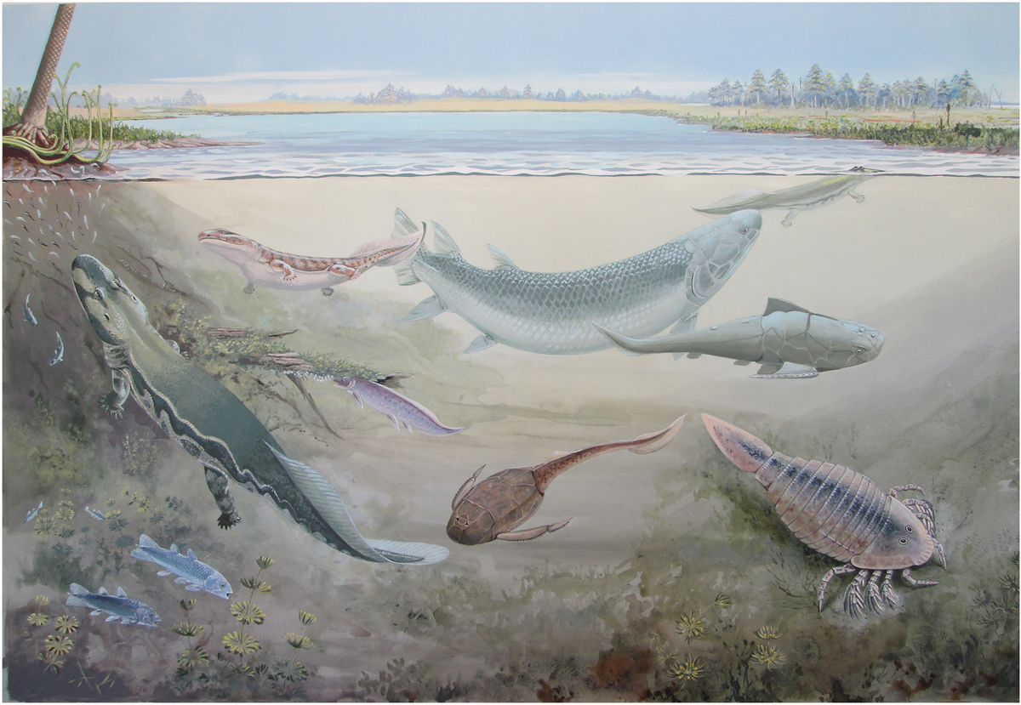
Pattern Recognition in the Brain
Sensory Evolution: From Detection to Pattern Recognition
Ancient origins
Specialized organs
Topographic organization
Notes:
Before we look at individual senses, it helps to step back and see how sensation itself evolved.
The story of pattern recognition begins long before the neocortex—deep in the early vertebrate lineage.
From the start, the challenge was the same: how to extract meaningful patterns from an ocean of raw physical energy.
The earliest animals had diffuse sensory cells scattered across the body
—detecting light, pressure, or chemical gradients but without much organization.
In vertebrates, these receptors became concentrated into specialized sensory organs:
eyes, ears, lateral lines, olfactory pits, and taste buds.
Each organ evolved from the same basic plan
—clusters of receptor cells feeding into arrays of neurons that preserve the spatial or chemical layout of the world.
This was the origin of topographic organization: the idea that nearby receptors map to nearby neurons,
preserving the structure of the stimulus.
You can see this in the retina’s layout of light-sensitive cells, in the tonotopic map of sound frequencies in the inner ear,
and in the somatosensory body maps that represent the skin.
These sensory maps are the foundation of vertebrate pattern recognition.
They turn distributed energy into organized information
—a spatial or chemical pattern that the rest of the brain can interpret and learn from.
From this point on, evolution builds complexity not by inventing new senses,
but by refining these ancient, patterned ones.

Slide 9
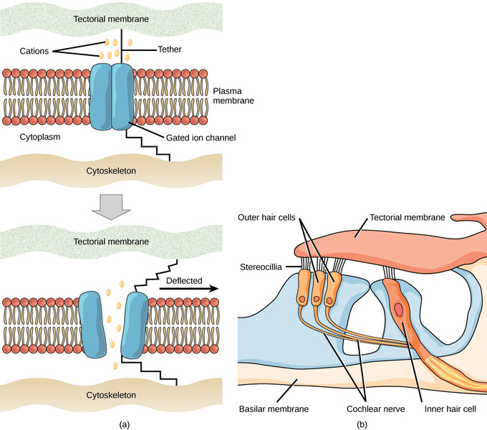
Pattern Recognition in the Brain
Somatosensory Transduction
Physical deformation → electrical signal
Ion channels and receptor diversity
From surface contact to neural code
Notes:
Touch begins with the mechanoreceptors embedded in the skin and body surface.
These are specialized cells that convert physical deformation into electrical activity
—a process known as transduction.
When pressure, stretch, or vibration distorts the cell membrane,
mechanically gated ion channels open, allowing charged particles to flow in and trigger a neural impulse.
Different receptor types are tuned to different forms of deformation:
some respond best to steady pressure, others to rapid vibration, and still others to the bending of hair follicles.
This diversity gives vertebrates sensitivity to texture, motion, and fine detail.
This basic mechanism—mechanical force opening ion channels
—is conserved across all vertebrates and even found in some invertebrates.
It represents one of the most direct forms of sensory translation:
a physical event in the world becoming an electrical signal in the nervous system.

Slide 10
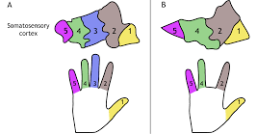
Pattern Recognition in the Brain
Somatosensation Pattern Formation
Spatial mapping
Body geometry preserved
Local feature detection
Notes:
The signals from mechanoreceptors enter the spinal cord through the dorsal roots,
where they maintain the spatial arrangement of the body surface.
This organization continues through the brainstem, forming somatotopic maps
—ordered neural representations in which neighboring skin areas are represented by neighboring neurons.
This mapping preserves the body’s geometry within the nervous system.
It allows touch to be localized, so the organism knows where on the body the stimulus occurred.
Groups of neurons respond to combinations of nearby stimuli,
forming the first local feature detectors for shape, motion, or texture.
These somatotopic maps are found in all vertebrates
—from fish to mammals.
In fish and amphibians, they already guide precise reflexes and orientation behaviors.
In later vertebrates, these same maps were extended and duplicated in higher regions,
but their basic organization never changed.

Slide 11
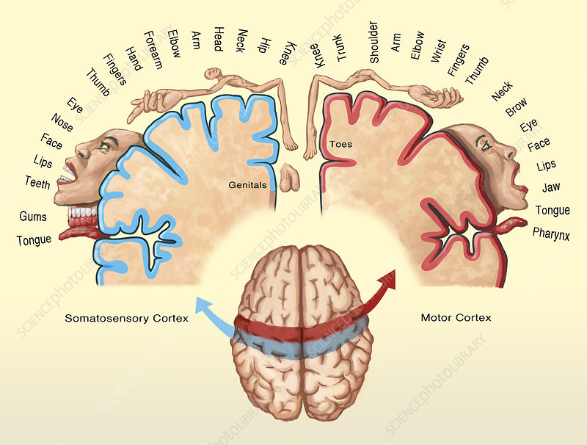
Pattern Recognition in the Brain
Somatosensation in the Brain
Spinal and brainstem circuits
Tectum and pallium
Precursors of sensory neocortex
Notes:
In the earliest vertebrates, touch information mainly served to drive reflexes
—automatic withdrawal or orientation movements.
These pathways connected directly from the skin to the spinal cord and brainstem,
allowing fast reactions without higher processing.
As vertebrate brains became more complex,
this same somatosensory input began to reach the midbrain tectum,
where it could be integrated with vision and hearing to guide coordinated movement.
Here, the first cross-modal maps of space began to appear,
allowing animals to align touch, sight, and sound in a shared frame of reference.
A further evolutionary step brought these signals into the pallium
—the primitive forebrain structure that would later give rise to the mammalian cerebral cortex.
In fish, amphibians, and early reptiles, the pallium could already combine touch signals over time and space,
turning simple contact sensations into structured perceptions of shape, texture, or movement.
Students may recognize the modern somatosensory cortex diagram
that shows the body mapped across the surface of the human brain.
That familiar “body map” doesn’t exist yet at this stage—but its blueprint does.
The spatial and patterned organization that later became the cortical homunculus
is already present in these early vertebrate systems,
just implemented in simpler, more compact circuitry.
By the time true neocortex evolved, evolution didn’t need to invent a new function
—only to expand and refine one that had been in place for hundreds of millions of years.

Slide 12
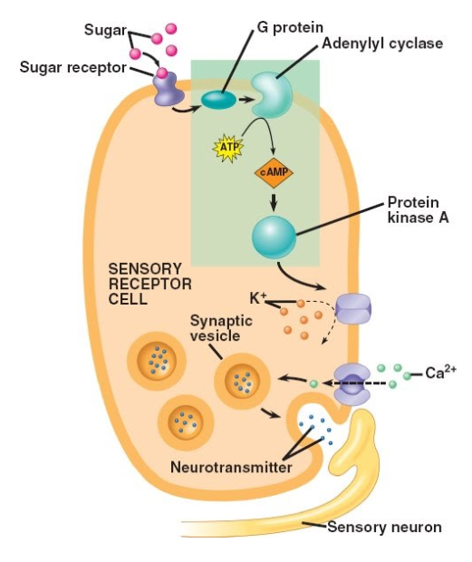
Pattern Recognition in the Brain
Chemosensory Transduction
for Smell and Taste
Molecular binding
Receptor diversity
Translating chemistry to electricity
Notes:
Smell and taste are the earliest sensory systems in evolution, tracing back even before the origin of vertebrates.
Their common foundation is chemosensation—the ability to detect and respond to specific molecules in the environment.
In vertebrates, this is achieved by specialized receptor cells that translate chemical information into neural signals.
Each olfactory or gustatory receptor cell contains receptor proteins that change shape when they bind to certain molecules.
That binding activates internal chemical cascades, opening ion channels and producing an electrical signal.
In this way, a physical event in the world—a molecule contacting a receptor—is converted into a neural impulse.
Different receptor types respond to overlapping sets of molecules.
Each molecule activates a unique combination of receptors, producing a combinatorial code.
This means the brain doesn’t have a “one receptor per smell” system, but a pattern-based one
—able to represent thousands of odors and flavors with a limited number of receptor types.
This molecular pattern recognition is deeply conserved: the same logic is found across all vertebrates,
and even in many invertebrates.
It is the biological origin of the idea that patterns—not single detectors—encode information.

Slide 13
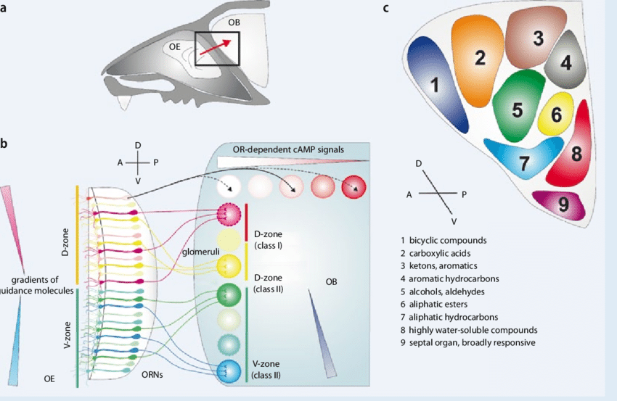
Pattern Recognition in the Brain
Chemosensory Pattern Formation
Olfactory bulb and glomeruli
Topographic organization
Distributed representations
Notes:
Once transduced, chemical signals are sent from receptor cells to the olfactory bulb (for smell)
or to cranial nerve nuclei in the brainstem (for taste).
In the olfactory bulb, neurons from receptor cells expressing the same receptor type
project to the same cluster of neurons called a glomerulus.
This creates an orderly map of chemical space
—similar in spirit to how the retina maps visual space or the skin maps touch.
These glomerular maps preserve relationships among molecular features,
such that similar smells activate overlapping regions and dissimilar smells activate distinct ones.
In other words, the olfactory bulb encodes chemical similarity as spatial proximity.
In taste, a comparable form of organization emerges: receptor cells for sweet,
salty, sour, bitter, and umami project to distinct regions of the brainstem,
where their signals remain partly segregated before being combined.
Both systems use population codes to represent mixtures and combinations, rather than single-feature signals.
This organizational logic—pattern-based representation and spatial mapping of features
—appears in all vertebrates, from fish to mammals.
It shows that even the earliest sensory systems used distributed codes
and structured mappings to make sense of the chemical world.

Slide 14
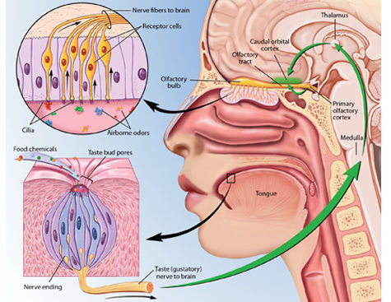
Pattern Recognition in the Brain
Chemosensory Brain Pathways
From olfactory bulb to pallium
Taste and internal state
Precursors of emotion and memory
Notes:
In early vertebrates, the outputs of smell and taste systems
projected to regions of the forebrain pallium and to the limbic forebrain,
including structures homologous to the modern amygdala and hippocampal formation.
These regions linked chemosensory patterns with internal states like hunger, fear, or reproduction.
For smell, signals from the olfactory bulb reached the olfactory pallium,
the direct evolutionary precursor to the mammalian piriform cortex.
This region allowed combinations of odor features to be learned and recognized as meaningful objects
—such as food sources, mates, or predators.
For taste, input from the brainstem was combined
with information about the animal’s internal condition (e.g., nutrient levels, hormonal state).
This integration allowed taste to serve not only as a sensory signal but as a regulatory one,
guiding feeding and avoidance behaviors.
These early forebrain circuits laid the groundwork for emotional and associative learning.
When a smell or taste became linked with a positive or negative outcome,
that pattern was stored and later used to predict future value.
This is the ancient root of what later became emotion and episodic memory in higher vertebrates.
In short, the olfactory and gustatory systems did more than detect chemicals
—they built the first bridges between sensory patterns, internal states, and learned significance.

Slide 15
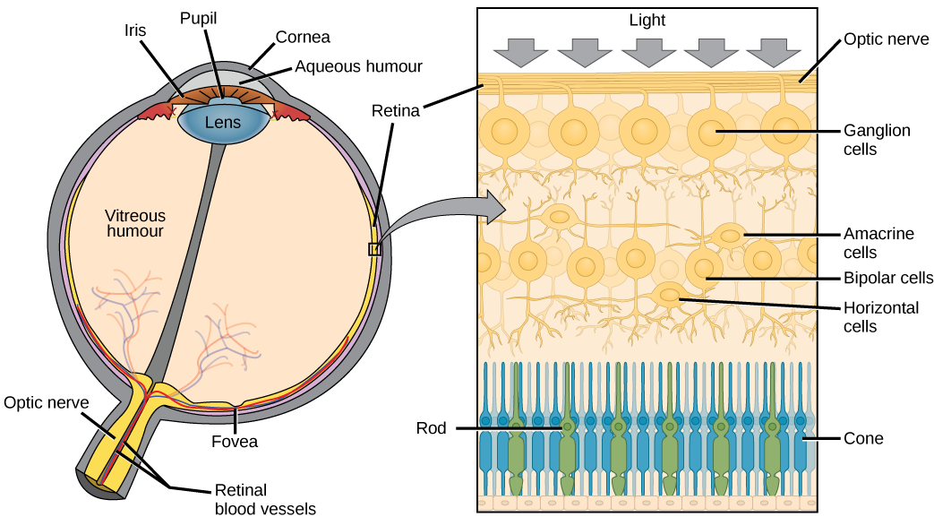
Pattern Recognition in the Brain
Retinal Transduction: Turning Light into Signals
Photoreceptors and opsins
Light to electricity
Preserving spatial layout
Notes:
Vision begins with the retina, a thin sheet of neural tissue at the back of the eye
that converts light into electrical signals.
This conversion is carried out by photoreceptor cells—rods and cones
—which contain light-sensitive molecules called opsins.
When a photon of light strikes an opsin, it changes shape,
triggering a cascade of chemical reactions that close ion channels in the membrane.
This change in current generates a signal that reflects local light intensity.
Rods are more sensitive and operate in dim light; cones respond in brighter conditions
and to different wavelengths, enabling color discrimination.
Importantly, the retina preserves the spatial layout of light on the eye’s surface:
each photoreceptor corresponds to a particular point in visual space.
This one-to-one correspondence creates a map of the external world on the surface of the retina.
This basic phototransduction mechanism—opsins responding to light, transforming photons into electrical activity
—is present in all vertebrates and even in some early chordates.
It is one of the most ancient and conserved examples of neural information processing.

Slide 16
Pattern Recognition in the Brain
Retinal Pattern Formation
Layered processing
Lateral inhibition
Edge and contrast detection
Notes:
The retina doesn’t simply send raw brightness values to the brain
—it performs the first stage of pattern recognition itself.
Light signals from photoreceptors are processed through several layers of neurons:
bipolar cells, horizontal cells, amacrine cells, and ganglion cells.
The ganglion cells’ axons form the optic nerve, but before that signal leaves the eye,
it has already been heavily transformed.
A key mechanism here is lateral inhibition.
Horizontal cells connect neighboring photoreceptors, allowing active regions to suppress their neighbors.
This sharpening of contrast emphasizes edges—places where light intensity changes abruptly.
As a result, uniform areas of brightness are de-emphasized, while boundaries and patterns are amplified.
This organization makes the retina functionally analogous to a small neural network.
It has layers, local connectivity, and feature detectors that extract structure from input.
In all vertebrates, this same architecture
—feedforward and lateral connections performing spatial filtering
—creates a primitive “edge map” of the world long before the signal reaches the brain.

Slide 17
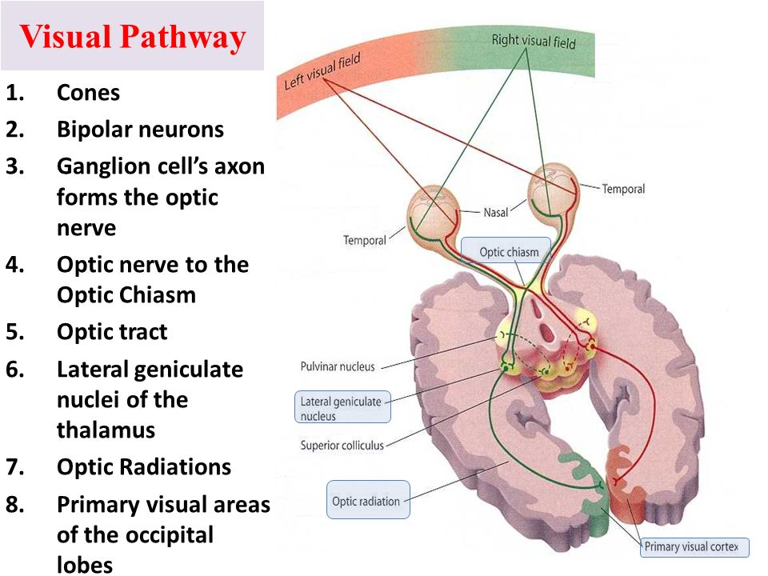
Pattern Recognition in the Brain
Early Brain Processing of Vision
Routing through the tectum
Visual maps and orientation
Precursors of cortical vision
Notes:
Once retinal signals exit the eye, they project primarily to the optic tectum
(known in mammals as the superior colliculus).
Here, a retinotopic map preserves the spatial layout of the visual world,
allowing the animal to orient toward movement or novelty.
In fish and amphibians, the tectum is the main visual processing center,
responsible for detecting prey, predators, and motion patterns.
This structure is one of the oldest multisensory integration hubs in the vertebrate brain.
It doesn’t only represent vision—it aligns visual, auditory,
and somatosensory inputs into a shared coordinate frame for action.
In doing so, it performs one of the earliest and most essential pattern-recognition functions:
linking what is seen to what should be done.
Later in evolution, some retinal projections also reached the pallium,
the forebrain precursor to the mammalian visual cortex.
At this stage, these inputs were still relatively simple,
but they allowed for combining visual patterns with memory, context, and learning.
So the visual cortex familiar from modern brain diagrams did not exist yet—but its precursors did.
The spatially organized, feature-detecting,
predictive circuits of early vertebrates laid the foundation for the layered visual cortex
that would emerge hundreds of millions of years later.

Slide 18
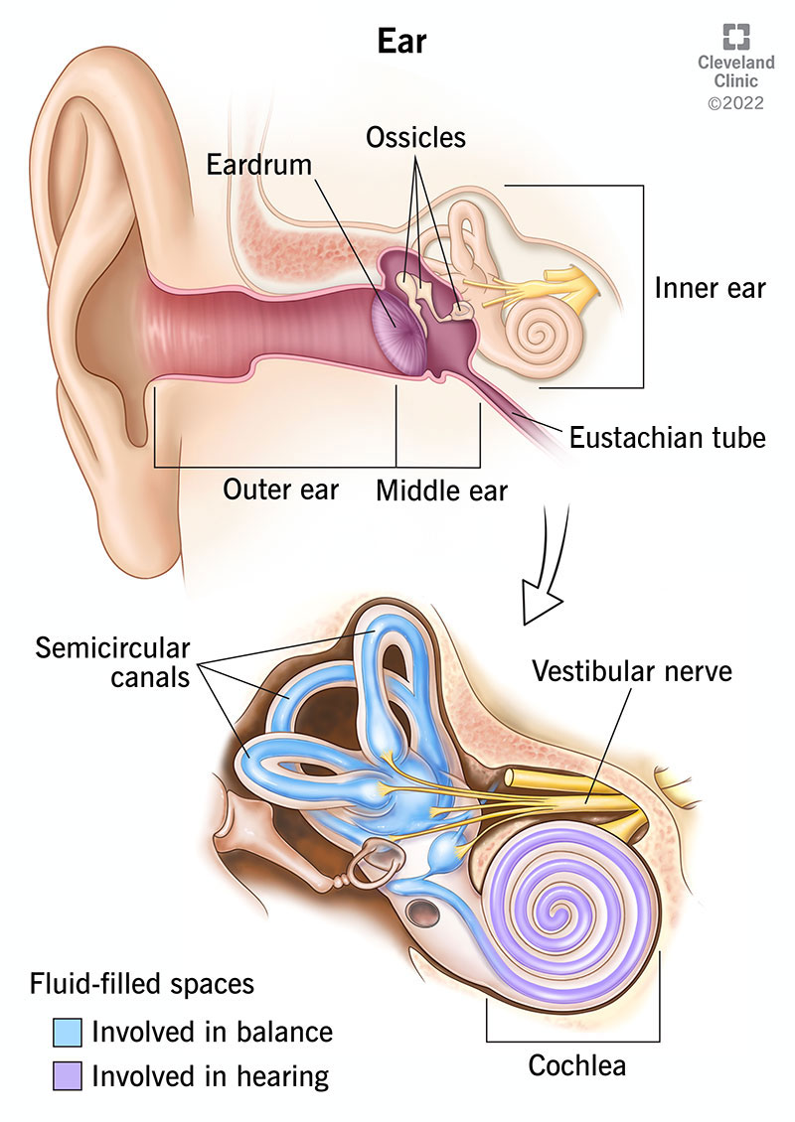
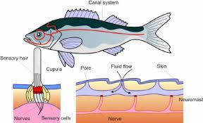
Pattern Recognition in the Brain
Auditory Transduction: From Lateral Line to Hair Cell
Hair cells and vibration
From water to air
Evolutionary tinkering
Notes:
Hearing began not with air, but with water.
Early fish had a lateral line system running along their bodies
—rows of small sensory organs that detected water motion.
Each organ, or neuromast, contained clusters of hair cells
whose tiny projections bent when the surrounding fluid moved.
That bending opened mechanically gated ion channels,
converting physical motion directly into electrical signals.
It was a simple but elegant motion detector: fluid moves → hair bends → neuron fires.
When vertebrates later ventured onto land, this system faced a problem.
Air is far less dense than water—too thin to move hair cells directly.
Yet evolution couldn’t start over; it had to preserve the same basic mechanism.
So, in true evolutionary fashion, it built an elaborate workaround to make air vibrations move fluid again.
First came the tympanic membrane, or eardrum
—a thin sheet that vibrates with sound waves in air.
Attached to it is a chain of tiny bones—the malleus, incus, and stapes
—that amplify and transmit those vibrations inward.
At the end of this chain sits the cochlea, a fluid-filled spiral chamber in the skull.
The bones shake the cochlear fluid, which bends the hair cells lining the basilar membrane
—recreating, inside the head, the same physical process that fish used on their skin.
It’s a remarkable case of evolutionary conservation through complexity.
Rather than designing a new kind of receptor for air,
vertebrates constructed a mechanical Rube Goldberg machine
to reproduce the original aquatic stimulus: motion of fluid bending hair cells.
Every time you hear a sound, you are using an ancient mechanosensory system
—just with a few extra levers, membranes, and tubes interposed to make the physics work in air.
This chain of adaptations beautifully illustrates how evolution operates:
not by inventing new solutions from scratch,
but by modifying existing parts to meet new environmental demands.
The modern ear, in all its intricacy, is living evidence of that continuity
—from fish sensing ripples in water to humans hearing music in air.

Slide 19
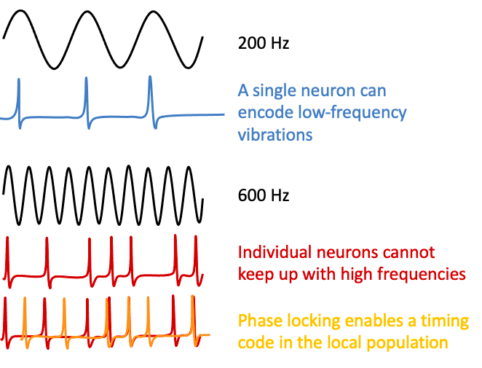
Pattern Recognition in the Brain
Auditory Neural Pattern Formation
Frequency mapping
Spatial coding of sound
Conserved neural logic
Notes:
Inside the cochlea, sound waves cause different regions of the basilar membrane
to vibrate depending on their frequency.
High-frequency sounds peak near the base, low-frequency ones near the apex.
This produces a tonotopic map—a systematic spatial representation of pitch.
Each hair cell along the membrane connects to auditory-nerve fibers tuned to that frequency.
These fibers carry the tonotopic organization into the brainstem,
where it is preserved through successive stages of processing.
Neurons there begin to extract additional information:
timing differences, intensity contrasts, and harmonic relationships.
This arrangement transforms the time-varying vibration of sound
into a stable spatial pattern of neural activation.
It’s one of the earliest examples of a topographic representation in the brain
—analogous to the retinotopic and somatotopic maps in vision and touch.
The principle is conserved across all vertebrates:
a continuous physical dimension (frequency, space, light)
becomes encoded as a continuous pattern of neural activity.

Slide 20
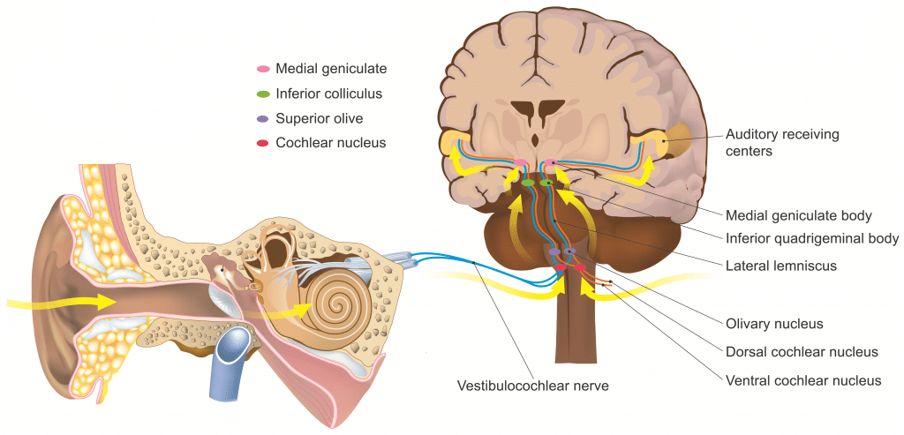
Pattern Recognition in the Brain
Auditory Brain Integration: Sound, Space, and Action
Brainstem processing
Tectal integration
From reflex to perception
Notes:
Signals from the cochlea first reach nuclei in the brainstem, where neurons compare the inputs from both ears.
By computing tiny differences in timing and intensity, these circuits estimate the direction a sound is coming from.
This allows even small vertebrates to orient toward prey, predators, or mates—often within milliseconds.
From there, projections ascend to the midbrain tectum (also called the optic tectum in fish and amphibians, or superior colliculus in mammals).
Here, auditory information is aligned with the visual and somatosensory maps we discussed earlier.
This alignment creates a multisensory spatial map, allowing the animal to integrate what it hears, sees, and feels into a single, coherent representation of nearby space.
At this evolutionary stage, the system primarily supports orienting and approach–avoidance behaviors rather than abstract recognition.
Yet these tectal circuits already implement the same computational logic that higher brain regions will later refine:
combining patterns across space and time, aligning them across modalities, and using them to guide adaptive action.
Over time, some auditory projections also reached the pallium, the forebrain region that would eventually give rise to the mammalian auditory cortex.
But the essential pattern-recognition machinery was already in place long before then—mapping vibration to space, and sound to meaning, through conserved vertebrate circuits.

Slide 21
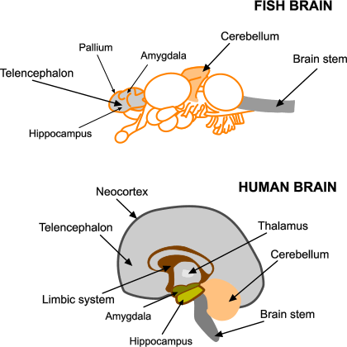
Pattern Recognition in the Brain
Conserved Brain Systems for Pattern Recognition
Shared neural architecture
Functional specialization
Integration across systems
Notes:
Across vertebrates, we find the same set of brain structures performing the same core functions of pattern recognition.
Despite enormous diversity in size and complexity,
the underlying architecture has remained remarkably stable for over 500 million years.
These conserved systems—the tectum, basal ganglia, cerebellum, thalamus, and pallium
—each contribute to pattern recognition in different ways.
Some extract patterns from sensory input, others learn associations between context and action,
and still others predict or coordinate the results of movement.
Together they form an interconnected network for recognizing, responding to,
and learning from environmental regularities.
This organization appears early in vertebrate embryos, suggesting a shared developmental blueprint.
Fish, reptiles, birds, and mammals all exhibit homologous circuits that carry out similar computations,
even when the outward form of their brains looks quite different.
You can think of these systems as the core modules of vertebrate intelligence
—ancient pattern recognizers that evolved long before language or reasoning.
Understanding what each does gives us a map of how the vertebrate brain
transforms sensory patterns into coordinated perception and behavior.

Slide 22
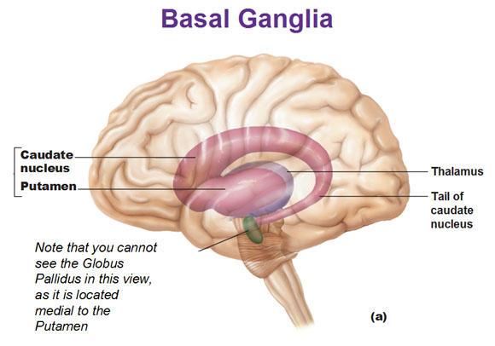
Pattern Recognition in the Brain
Basal Ganglia and Context–Action Patterns
Learning from reward
Selecting actions
Contextual pattern recognition
Notes:
The basal ganglia are another ancient and highly conserved system, present in all vertebrates.
They form a network of interconnected nuclei deep within the forebrain that learn and regulate patterns linking context, action, and reward.
At their core, the basal ganglia act as an action selection system.
They receive input from sensory and motor regions, evaluate which behaviors are most appropriate,
and facilitate or suppress actions accordingly.
Learning which patterns lead to success or failure depends on dopamine,
a chemical signal that reports reward prediction error
—whether an outcome was better or worse than expected.
This dopamine-based reinforcement signal shapes which action patterns are strengthened and which are weakened.
Over time, the system learns to recognize familiar contexts
and automatically trigger the actions that have been most rewarding in the past.
That’s why these circuits are essential for habits, skills, and goal-directed behavior.
Although the structure looks simple—loops connecting cortex, basal ganglia, and thalamus
—it captures a deep computational principle:
pattern recognition not of sensory input, but of situations
—internal and external contexts that predict valuable outcomes.
In early vertebrates like fish, these circuits already controlled basic approach
–avoidance and navigational behaviors.
In mammals, they were elaborated to include complex motor sequences and decision making,
but the fundamental logic never changed.
Across vertebrates, the basal ganglia embody the brain’s ability to learn patterns of behavior that maximize success.

Slide 23
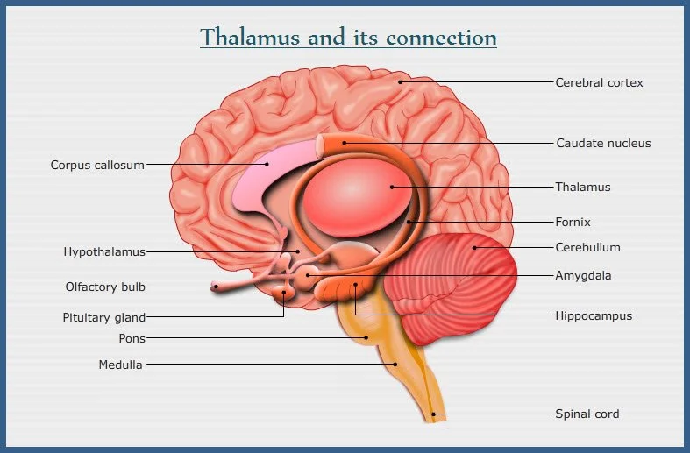
Pattern Recognition in the Brain
Thalamus and Sensory Gating
Filtering and routing
Timing and coordination
Dynamic pattern control
Notes:
The thalamus sits near the center of the brain and acts as a major hub for communication between sensory systems and the forebrain.
In every vertebrate, it serves as the main relay between incoming sensory signals and the regions that interpret them
—but it is far more than a passive switchboard.
Rather than simply forwarding information, the thalamus filters and modulates it.
Different thalamic nuclei emphasize, suppress, or synchronize signals depending on what the animal is doing or expecting.
This makes the thalamus a kind of gatekeeper, dynamically controlling which patterns reach higher centers and when.
Thalamic circuits also help maintain timing and coordination across distant brain areas.
Rhythmic oscillations between the thalamus and forebrain synchronize neural populations,
ensuring that sensory, motor, and associative regions communicate in phase.
In this way, the thalamus acts as the conductor of the vertebrate brain’s distributed pattern-recognition orchestra.
These functions appear even in early vertebrates.
In fish and amphibians, thalamic nuclei already route visual, auditory,
and somatosensory information to the pallium, modulating responses based on attention and arousal.
In mammals, these same nuclei expanded and specialized,
but their role remained the same: controlling the flow of patterns through the brain’s networks.
By regulating what information gets through and when,
the thalamus ensures that perception and action are not just reactive, but adaptive
—shaped by both the outside world and the organism’s internal state.

Slide 24
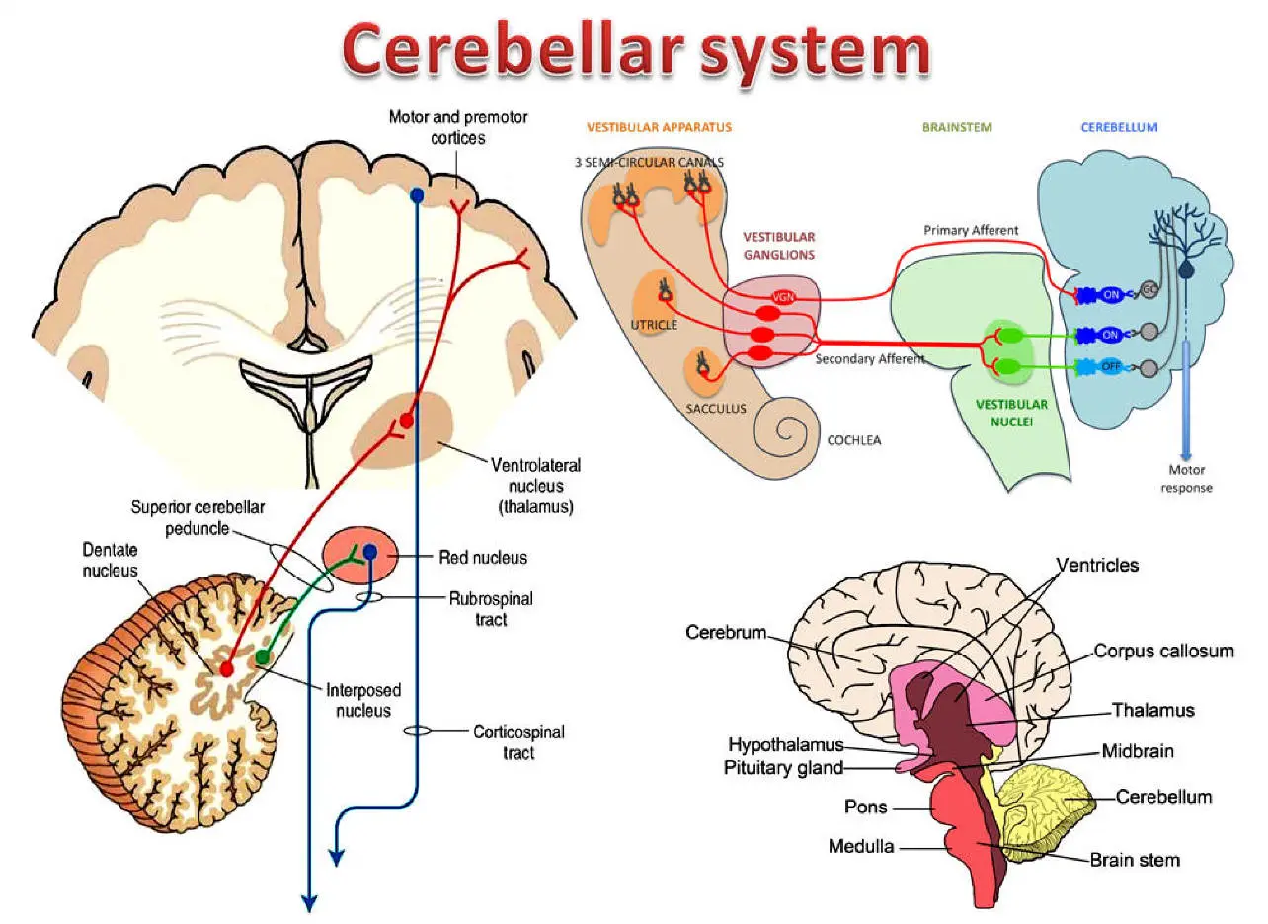
Pattern Recognition in the Brain
Cerebellum and Predictive Learning
Learning from error
Timing and coordination
Anticipating outcomes
Notes:
The cerebellum, or “little brain,” is one of the oldest and most conserved structures in vertebrates.
It first evolved in early jawed fish and has kept the same distinctive folded architecture ever since.
Its job is to learn predictions about how actions will unfold, so that movements—and eventually thoughts—can be timed and adjusted precisely.
Like the basal ganglia, the cerebellum learns from experience—but the two systems handle different kinds of learning.
The basal ganglia learn through reward and reinforcement: when an action leads to a good outcome, dopamine strengthens the pattern that produced it.
The cerebellum, in contrast, learns through error correction: it compares what was intended to what actually happened and adjusts connections to reduce future error.
One learns which action to take; the other learns how to carry it out more accurately.
Mechanistically, the cerebellum receives copies of motor commands from the brain alongside sensory feedback from the body.
It uses special input fibers—called climbing fibers and parallel fibers—to compute an error signal at Purkinje cells, the main output neurons of the cerebellar cortex.
Each trial fine-tunes the strength of these connections, gradually improving timing and coordination.
This same predictive logic appears across vertebrates.
Fish use it to stabilize gaze and adjust swimming; birds and mammals use it to refine locomotion, vocalization, and even thought sequencing.
The cerebellum thus embodies the brain’s capacity to learn expectations and adjust behavior before mistakes accumulate.
If the basal ganglia are the brain’s reinforcement learner, the cerebellum is its predictive controller—two complementary systems that together make learning fast, adaptive, and flexible.

Slide 25
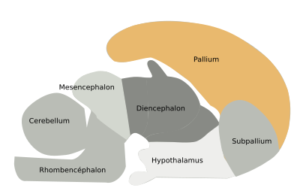
Pattern Recognition in the Brain
Cortex and Pallium
Integrating across modalities
Hierarchical representation
Flexible abstraction
Notes:
The pallium is the forebrain structure from which the mammalian cerebral cortex evolved.
All vertebrates possess some form of pallium, though it varies in complexity.
In early fish and amphibians, it was a relatively simple sheet of neurons; in reptiles and mammals,
it expanded and folded into the multi-layered cortex familiar to us today.
What makes the pallium distinctive is its integration of information across different sensory modalities and brain systems.
Where the tectum aligns spatial maps and the cerebellum fine-tunes movement,
the pallium combines sensory, motor, and contextual information into richer, more abstract representations.
It is the hub where perception, prediction, and decision-making converge.
At the microcircuit level, pallial and cortical organization mirror the same motifs we’ve seen throughout the brain:
distributed, hierarchical, and recurrent connections.
Information flows both upward—building abstraction from simple features—and downward—using expectations to interpret new input.
This architecture supports flexible generalization, enabling animals to apply learned patterns in novel contexts.
Evolutionarily, the expansion of the pallium didn’t invent new principles—it scaled up existing ones.
Fish, birds, and mammals all use pallial circuits to recognize complex patterns
and guide adaptive behavior, whether that’s a fish navigating a reef,
a bird recognizing a song, or a human interpreting language.
In this way, the cortex represents not a new kind of brain, but an old one made large: a vast associative sheet that extends the same pattern-recognition logic that has guided vertebrate behavior since its beginnings.

Slide 26
Pattern Recognition in the Brain
The Vertebrate Pattern-Recognition Engine
Distributed and hierarchical
Predictive and adaptive
Unified design principles
Notes:
When we step back and look across the vertebrate brain, a remarkable picture emerges.
The systems we’ve explored—the tectum, basal ganglia, thalamus, cerebellum, and pallium
—are not isolated modules but parts of a single, integrated pattern-recognition engine.
Each contributes a distinct function: the tectum for multisensory alignment,
the basal ganglia for reinforcement and selection,
the cerebellum for predictive control,
the thalamus for coordination,
and the pallium for flexible integration.
Despite these differences, they all share the same architectural motifs.
Neurons are organized in layers and loops; information is represented in distributed populations;
and feedback constantly refines perception and action.
These motifs recur so consistently across regions and species that they appear to be evolution’s universal solution
to the problem of learning from a dynamic world.
From the perspective of Marr’s levels, this is the implementational realization of everything we discussed earlier in the chapter.
The vertebrate brain embodies the same computational ideas
—hierarchical feature extraction, predictive learning, and distributed representation
—that define both cognitive models and modern AI systems.
What distinguishes biology is not the principles but the medium:
a living, adaptive network that grows and reorganizes itself over a lifetime,
using the same basic plan that first appeared in fish more than half a billion years ago.

Slide 27
Pattern Recognition in the Brain
Recap
Shared computational motifs
Evolutionary continuity
Brains as learning systems
Up Next
Spatial cognition
Curiosity, exploration, and the explore–exploit tradeoff
Notes:
We’ve now traced pattern recognition from computation to implementation—from the algorithms that extract structure to the neural systems that embody those algorithms in living tissue.
Across every vertebrate lineage, the same design principles reappear: distributed coding, hierarchical organization, feedback, and prediction.
These motifs are not confined to one brain area.
They shape how sensory organs detect structure, how circuits transform those inputs, and how larger systems coordinate perception, learning, and action.
The retina, tectum, basal ganglia, cerebellum, thalamus, and pallium all implement variations on the same core idea: learning to recognize patterns that matter for survival.
Seen in evolutionary context, this repetition is not redundancy—it’s a mark of continuity.
Each new system built upon earlier ones, extending the reach of pattern recognition from reflexes and perception to planning and thought.
That continuity also explains why modern artificial systems, when allowed to learn from experience, often rediscover architectures that echo biological ones.
The vertebrate brain, in this sense, is both a product of evolution and a proof of concept:
a robust, flexible, self-organizing pattern-recognition machine that has been refining its algorithms for over 500 million years.
Next time, we’ll move from recognizing patterns to seeking them.
Pattern recognition allows the brain to interpret the world—but learning those patterns in the first place requires active exploration.
Organisms must decide when to exploit what they already know and when to explore something new, a dilemma known as the explore–exploit tradeoff.
We’ll see how curiosity and intrinsic motivation drive that exploration, how neural circuits evaluate novelty and reward, and how spatial cognition provides the framework for navigating both physical and abstract spaces.
In other words, if today’s topic was about how the brain sees the world, next time we’ll ask how it moves through it—choosing where to look, what to try, and how to balance uncertainty against opportunity.

